Slide 1
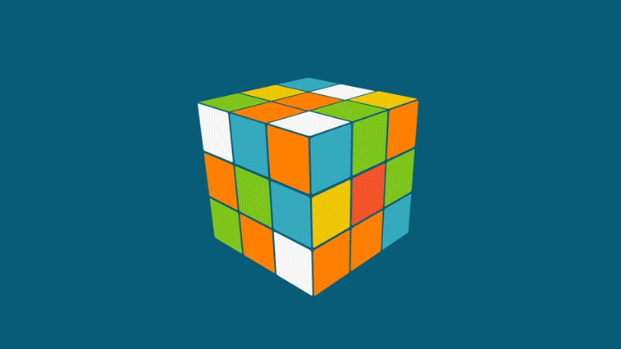
Rubik's Cube Visualization in OpenGL

Slide 2
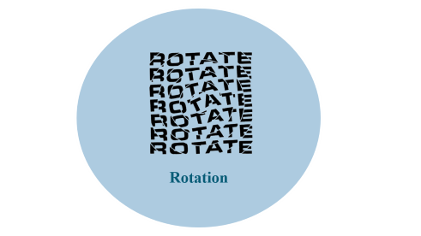

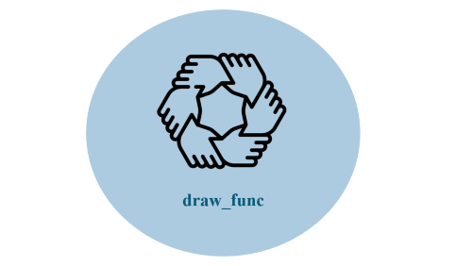
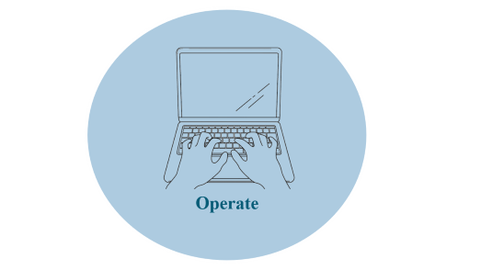
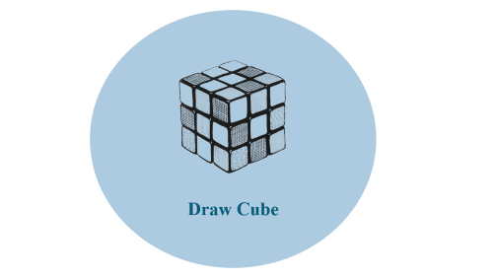
Rubik's Cube Visualization in OpenGL

Slide 3

Header

Slide 4
Header
#include <GL/glut.h> // Include the GLUT library for the GUI and handling user input
#include <GL/gl.h> // OpenGL functions
#include <vector> // Include the vector container from the Standard Template Library
using namespace std; // Use the standard namespace to avoid prefixing std::
struct cube_rotate {
GLfloat angle, x, y, z; // Structure for rotation with angle and axis (x, y, z)
};
GLfloat angle, fAspect, cube_size; // Variables for perspective angle, aspect ratio, and cube size
GLint rot_x, rot_y, crement, x_0, x_k, y_0, y_k, z_0, z_k, gap, gap_crement; // Variables for rotation, increments, and gaps
vector<cube_rotate> cube_rotations[3][3][3]; // 3D vector array for storing rotations of each cube segment
Function Prototypes
void load_visualization_parameters(void); // Function to set visualization parameters
void apply_rotation(GLfloat angle); // Function to apply rotation to a cube face

Slide 5

Rotation

Slide 6
Rotation
void apply_rotation(GLfloat angle) {
vector<cube_rotate> face[3][3]; // Temporary array to store the face that is rotated
int index;
cube_rotate rotation; // Temporary variable for a rotation
// Rotate the face and copy to temporary array
for (int i = 0; i < 3; ++i)
for (int j = 0; j < 3; ++j) {
index = 2 - j % 3; // Calculate new position index after rotation
// Determine rotation axis based on fixed axis values
if (x_0 == x_k) {
rotation = { angle, 1.0, 0.0, 0.0 }; // Rotate about x-axis
face[index][i] = cube_rotations[x_k][i][j];
}
if (y_0 == y_k) {
rotation = { angle, 0.0, 1.0, 0.0 }; // Rotate about y-axis
face[index][i] = cube_rotations[j][y_k][i];
}

Slide 7
if (z_0 == z_k) {
rotation = { -angle, 0.0, 0.0, 1.0 }; // Rotate about z-axis
face[index][i] = cube_rotations[j][i][z_k];
}
face[index][i].push_back(rotation); // Add new rotation to temporary array
}
// Copy the rotated face back to the main cube rotation array
for (int i = 0; i < 3; ++i)
for (int j = 0; j < 3; ++j) {
if (x_0 == x_k)
cube_rotations[x_k][i][j] = face[i][j];
if (y_0 == y_k)
cube_rotations[j][y_k][i] = face[i][j];
if (z_0 == z_k)
cube_rotations[j][i][z_k] = face[i][j];
}
}

Slide 8
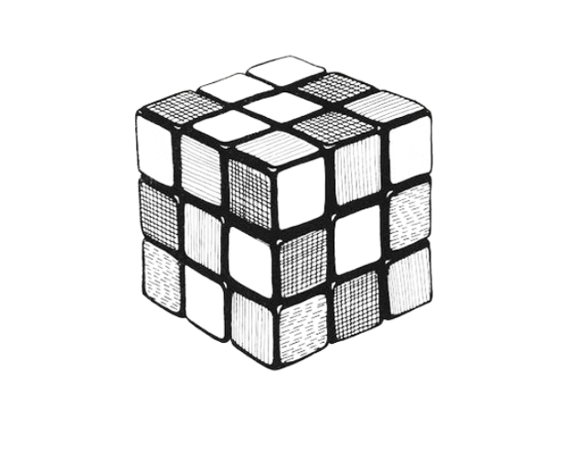
Draw Cube

Slide 9
Draw Cube
void draw_cube(int x, int y, int z) {
vector<cube_rotate> lrot = cube_rotations[x][y][z]; // Local rotations for the cube segment
glPushMatrix(); // Push the current matrix to the stack
glTranslatef((x - 1) * cube_size + x * gap, (y - 1) * cube_size + y * gap, (z - 1) * cube_size + z * gap); // Position the cube segment
// Apply rotations stored for this cube segment
for (int i = lrot.size() - 1; i >= 0; --i)
glRotatef(lrot[i].angle, lrot[i].x, lrot[i].y, lrot[i].z);
// Draw the six faces of the cube segment with different colors
glColor3f(1.0f, 0.0f, 0.0f); glBegin(GL_QUADS);
...
glEnd();
glPopMatrix(); // Pop the matrix off the stack
}

Slide 10

draw_func

Slide 11
draw_func
void draw_func(void) {
int x = -cube_size, y = -cube_size, z = -cube_size;
glClear(GL_COLOR_BUFFER_BIT | GL_DEPTH_BUFFER_BIT); // Clear the screen and depth buffer
glLoadIdentity(); // Reset transformations
set_camera(); // Set the camera position
glRotatef(rot_x, 1.0, 0.0, 0.0); // Apply rotation around x-axis
glRotatef(rot_y, 0.0, 1.0, 0.0); // Apply rotation around y-axis
// Draw all 27 cube segments
for (int i = 0; i < 3; ++i)
for (int j = 0; j < 3; ++j)
for (int k = 0; k < 3; ++k) {
draw_cube(i, j, k); }
glutSwapBuffers(); // Swap the buffers to display the current frame
}

Slide 12

Operate

Slide 13
Operate
The keyboard_func function is a callback used to handle keyboard input events.
It switches on the keyboard input (key) and performs corresponding actions, such as adjusting view rotation or cube movements.
After processing the input, it calls glutPostRedisplay() to mark the current window as needing to be redisplayed, triggering a call to the display function (draw_func).
The mouse_func function is a callback used to handle mouse button events.
It checks which mouse button is pressed (GLUT_LEFT_BUTTON or GLUT_RIGHT_BUTTON) and whether it's pressed (GLUT_DOWN) or released (GLUT_UP).
If the left button is pressed, it decreases the angle (used for zooming in) by 5 if the angle is greater than or equal to 10.
If the right button is pressed, it increases the angle (used for zooming out) by 5 if the angle is less than or equal to 130.
After updating the angle, it calls load_visualization_parameters to update the projection matrix based on the new angle, and glutPostRedisplay() to trigger a redraw of the window.

Slide 14
THANK YOU

